Slide 1
Machine Learning and Image Classification

Slide 2
Background
I paid for college as an animal tracker
Google provides an open-source Machine Learning API called TensorFlow
https://www.tensorflow.org/
Python has become a very popular scientific programming language

Slide 3
Goal
Explore Python and TensorFlow capabilities on track identification/interpretation

Slide 4
Machine Learning
according to Arthur Samuel, gives "computers the ability to learn without being explicitly programmed."

Slide 5
What to have it learn?
I needed a problem that was relatively easy for me to do but hard for me to explain how I do it.

Slide 6
Machine Learning Objective
Learn to identify “Left” and “Right” foot prints in the sand

Slide 7
Setup

Slide 8
Development Environment
I installed Python 3.6
https://www.python.org/downloads/
https://www.python.org/downloads/
I installed TensorFlow
https://www.tensorflow.org/install/install_windows
I installed Python Pillow (an Image API)
https://python-pillow.org/
I downloaded the Training Model code at:
https://github.com/googlecodelabs/tensorflow-for-poets-2

Slide 9
TensorFlow Learning Models
TensorFlow allows you to:
build up models from scratch
Retraining existing training models to suit your needs
I followed the tutorial at:
https://codelabs.developers.google.com/codelabs/tensorflow-for-poets/#3
This tutorial allows you to retrain an existing model

Slide 10
Download the model at:
https://github.com/googlecodelabs/tensorflow-for-poets-2

Slide 11
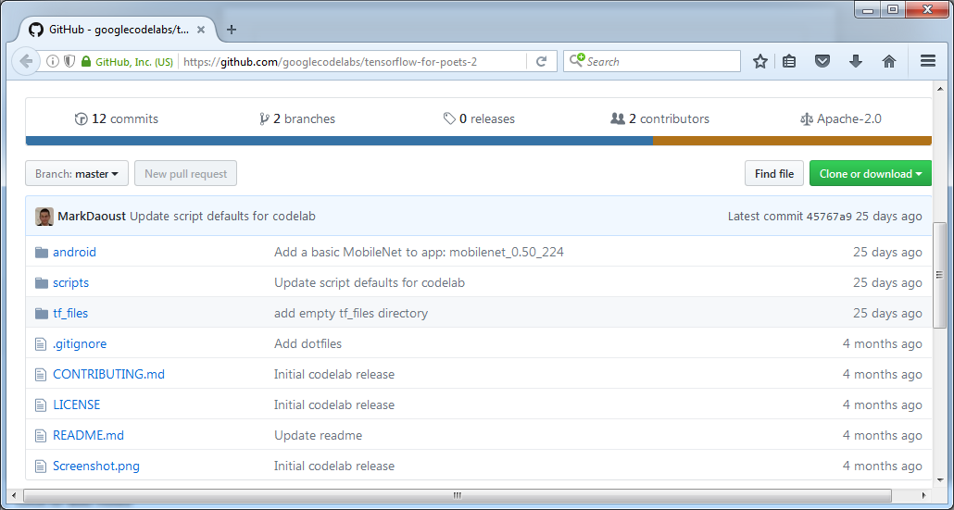

Slide 12
Download a MobileNet Model
https://research.googleblog.com/2017/06/mobilenets-open-source-models-for.html

Slide 13
Training Data
I went to Eagle Beach and took ~1000 pictures of footprints in the sand and mud from many angles and orientations.
I installed Python and wrote a small Python script to take a picture and accept the bounding box around the track in it.
The program reads in the image, rotates the image by one degree, calculates the new bounding box, crops the image and saves a new image file.
The program creates 360 images (one for each degree of rotation of the image)

Slide 14
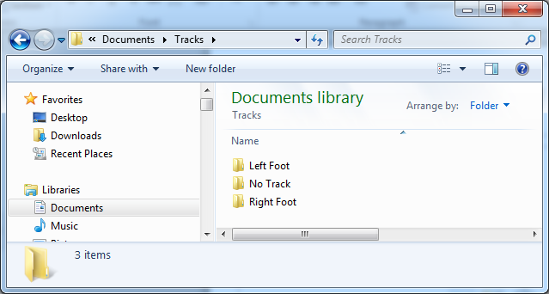
Images are stored in Folders that with names that define the ML image labels

Slide 15
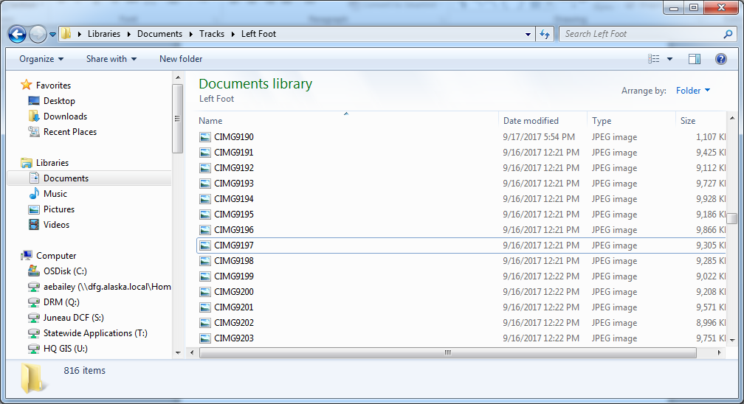

Slide 16
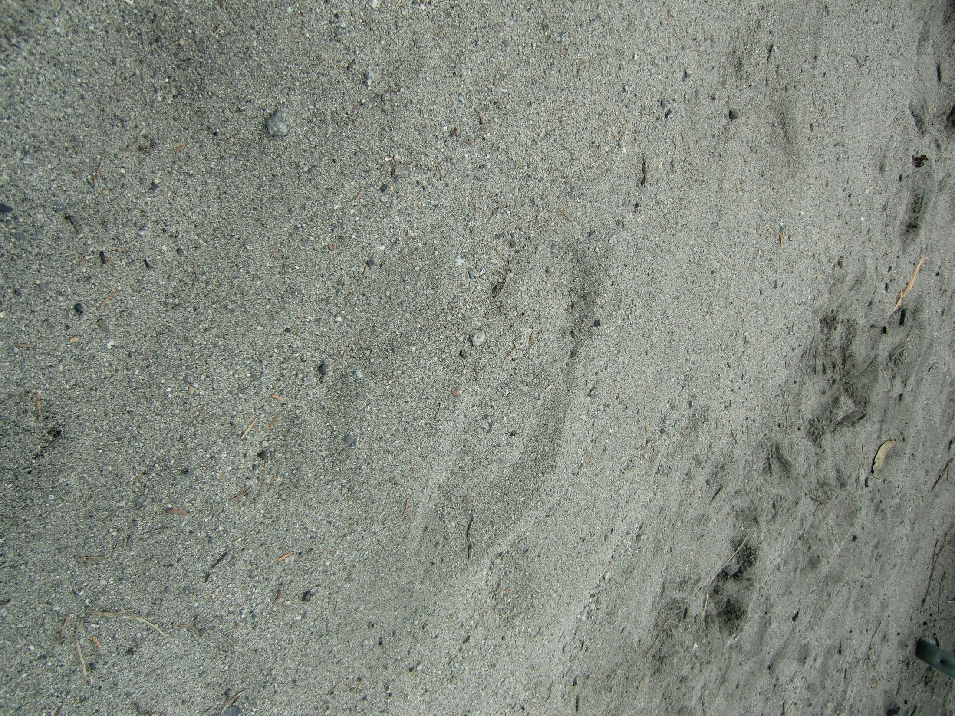

Slide 17
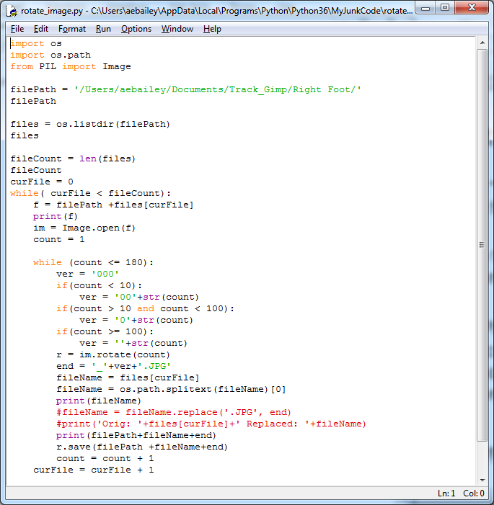

Slide 18
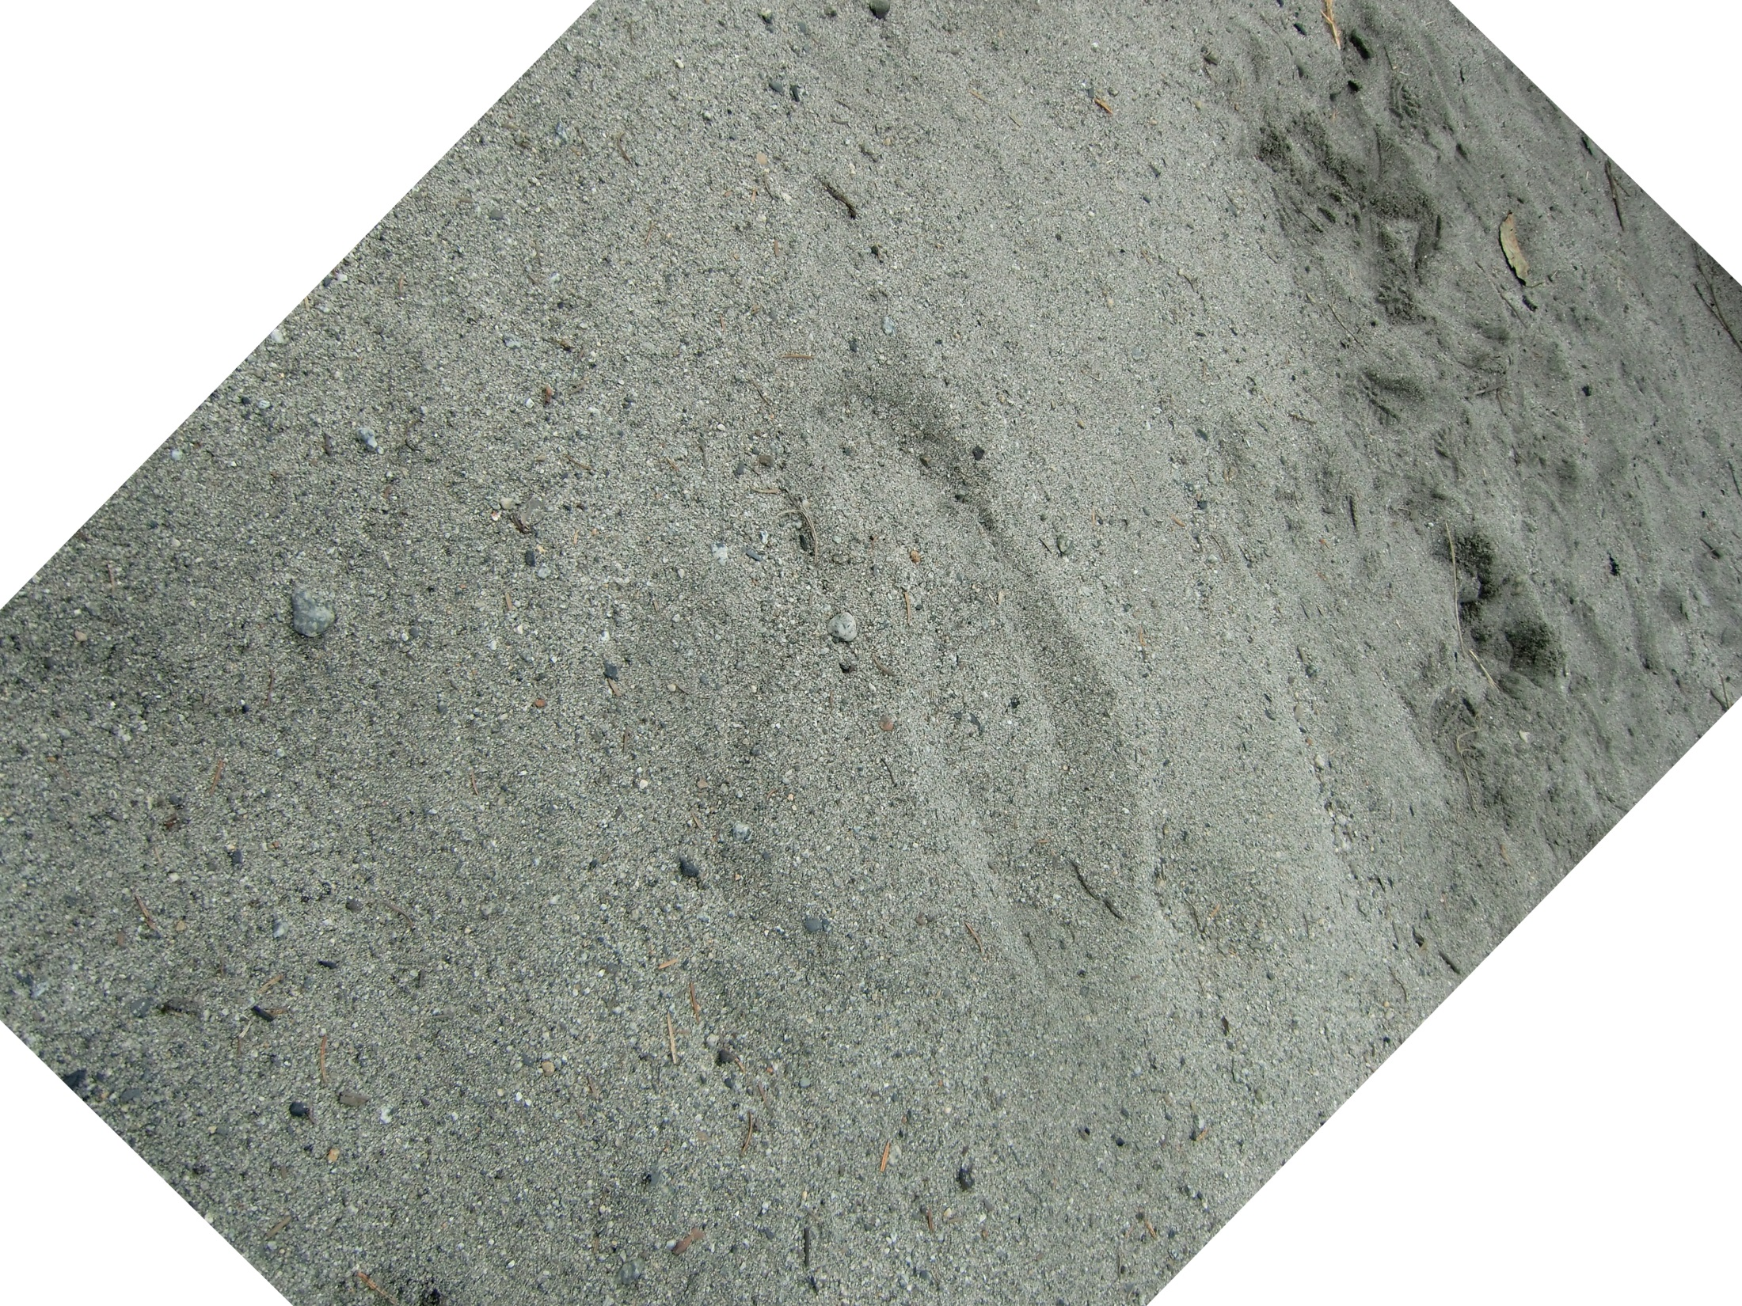

Slide 19
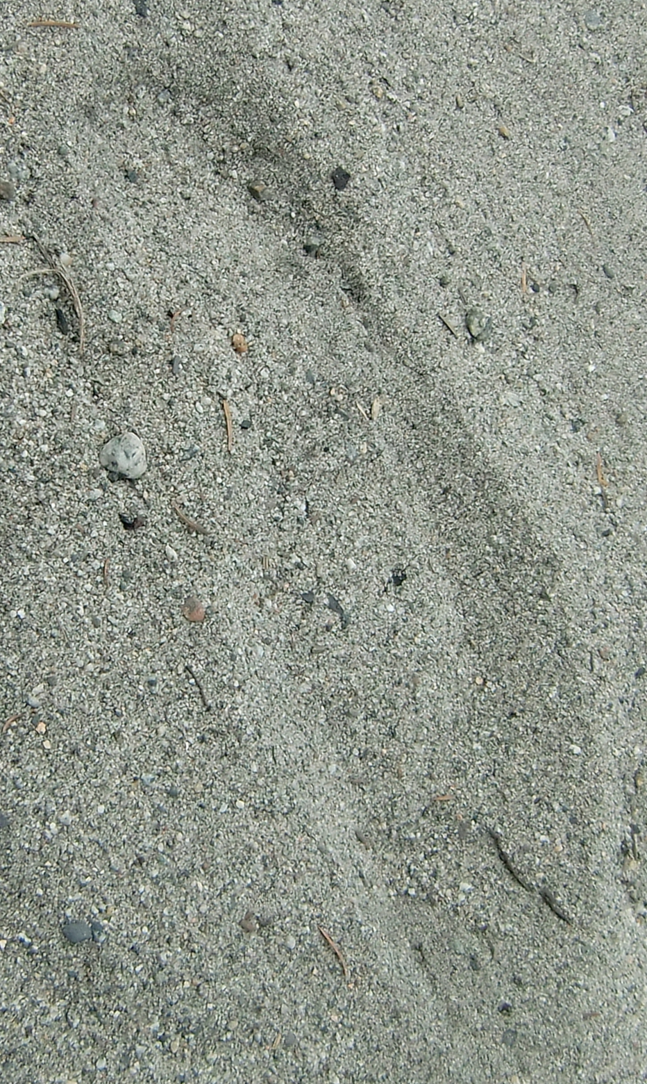

Slide 20
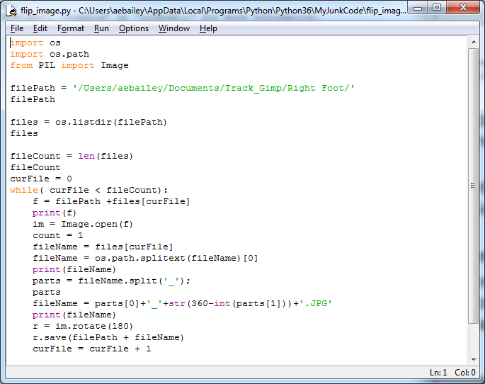

Slide 21
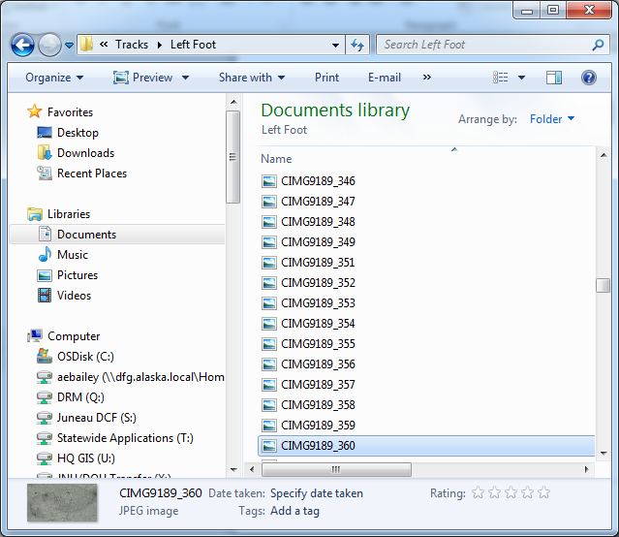

Slide 22
The Cropping Process is very Laborious
I spend one evening cropping images from 3:00 pm until 11:00 pm
In that time I produce a 360 images for ~5 original pictures.
Even after making the script take the original bounding box, it is still too slow.
I need the tool I am building in order to automate this process ☹
I need a very large image sample set – a million images would be much appreciated, thanks

Slide 23
Training

Slide 24
Batch Files
I created batch files to make running complex commands easier:
start_tensorboard.bat
Used to start a local server to graphically display the status of our model
retrain_tracks_batch.bat
Used to tell the model to “Go learn”
classify_track_image_batch.bat
Used to ask the model to label an image based on what it learned.

Slide 25
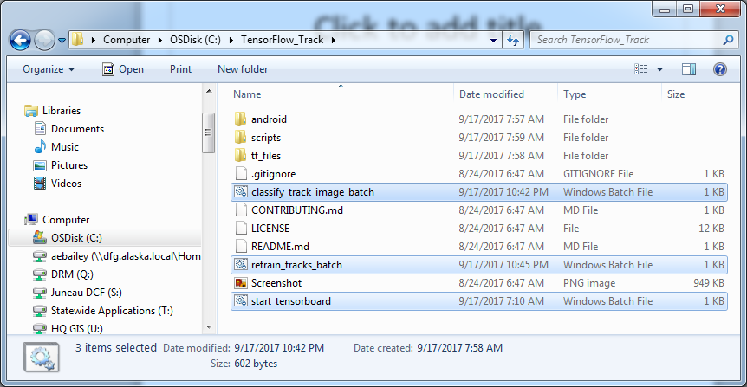

Slide 26
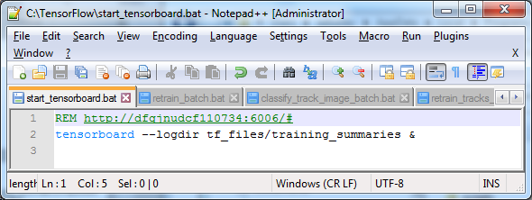
Start TensorBoard

Slide 27
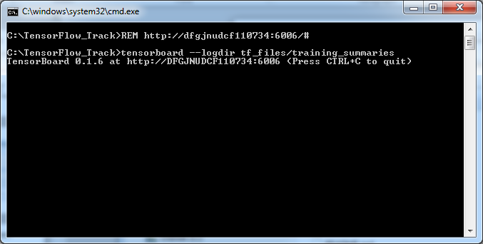
TensorBoard is now Started

Slide 28
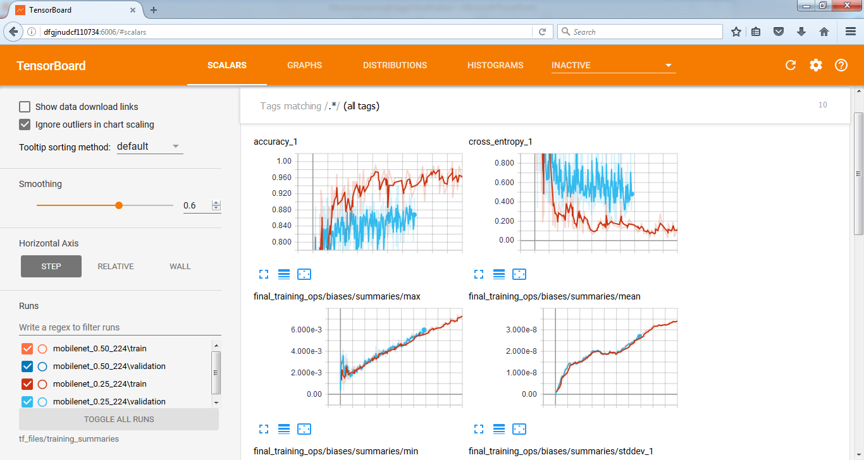

Slide 29
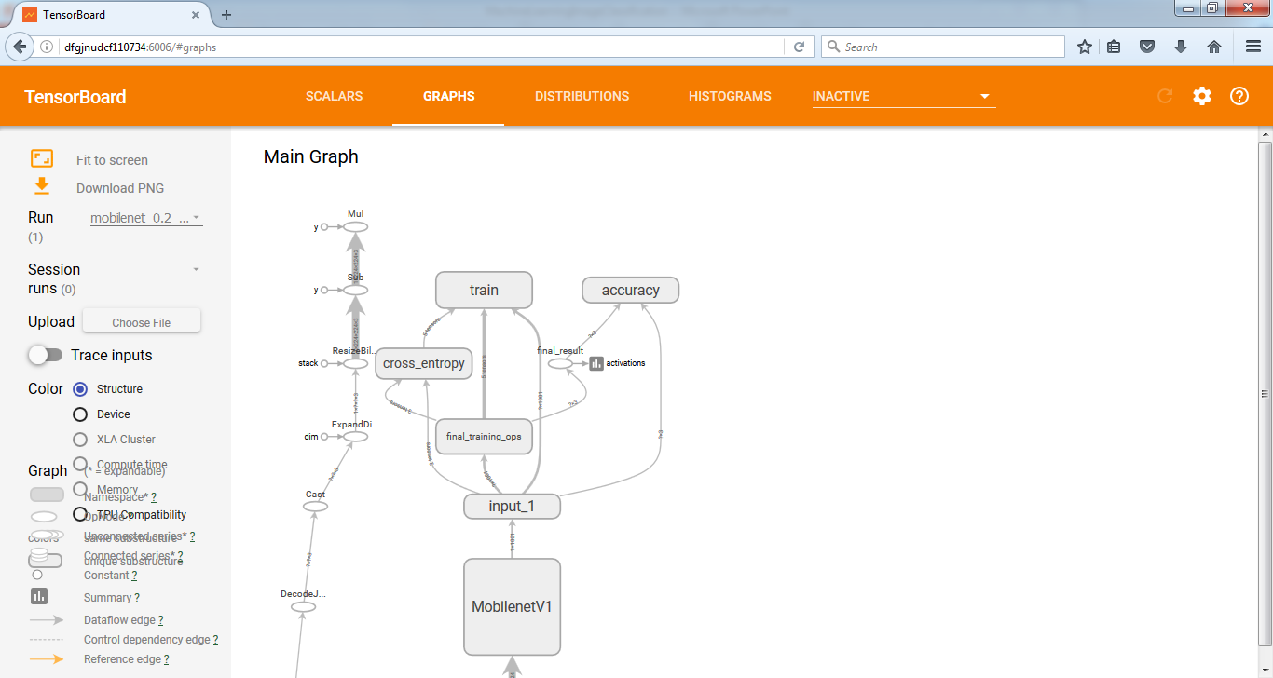

Slide 30
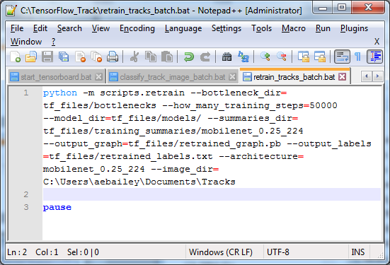
retrain_tracks_batch

Slide 31
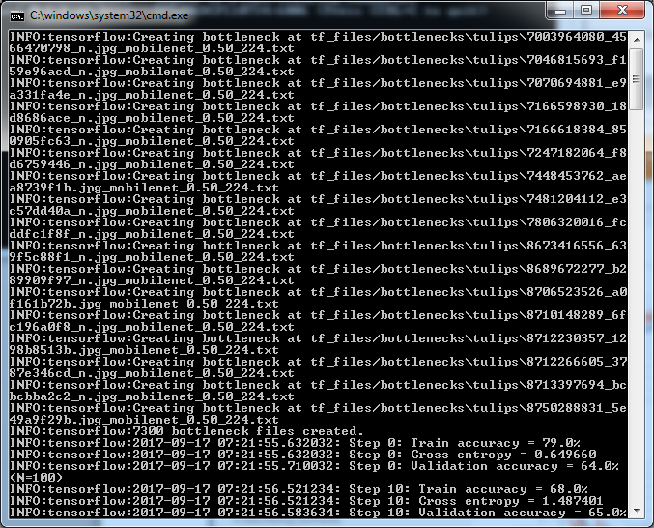

Slide 32
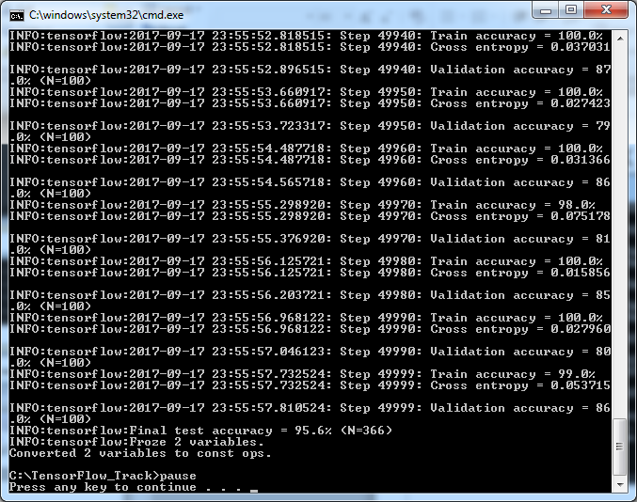

Slide 33
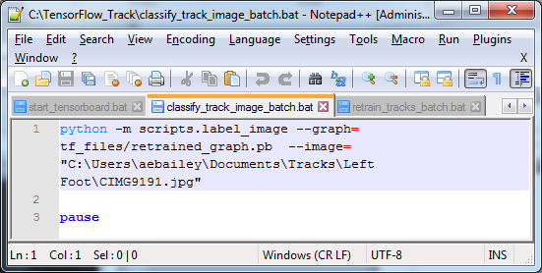
classify_track_image_batch

Slide 34
Left or Right Track?

Slide 35
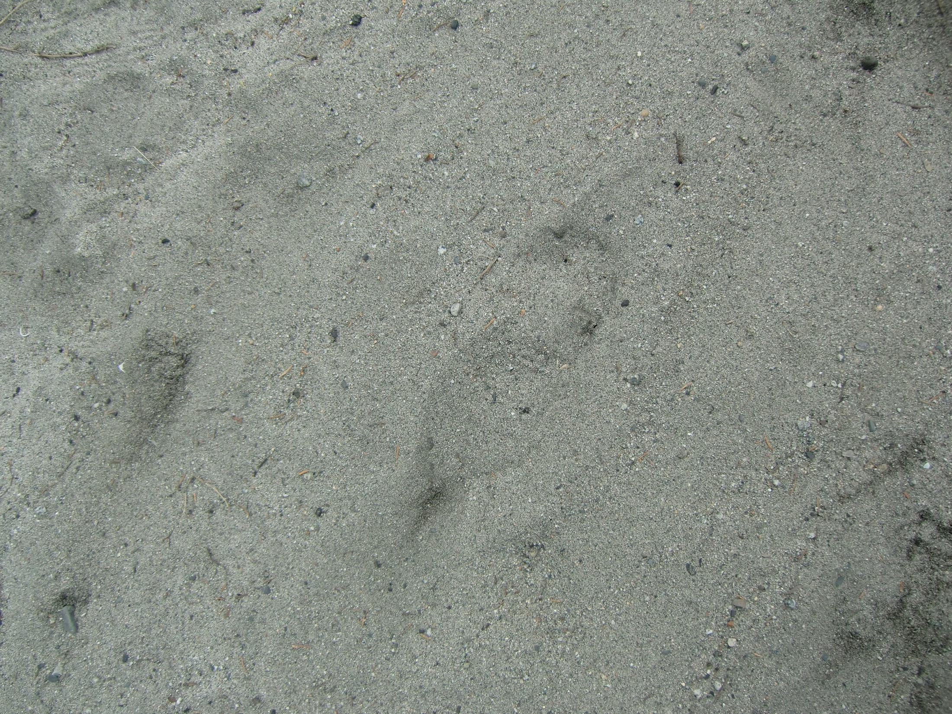

Slide 36
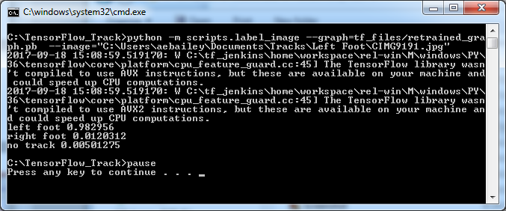

Slide 37
Conclusions
Training and Using the Tensorflow Image Classifiers is pretty quick and easy.
The hardest part is getting suitable training images.

Slide 38
Where do we go from here?
Object Detection and bounding boxes in Video or Static Images!
Object Detection
https://medium.com/towards-data-science/building-a-real-time-object-recognition-app-with-tensorflow-and-opencv-b7a2b4ebdc32
Raccoon Detection
https://medium.com/towards-data-science/how-to-train-your-own-object-detector-with-tensorflows-object-detector-api-bec72ecfe1d9
Mac & Cheese Detector
https://pythonprogramming.net/custom-objects-tracking-tensorflow-object-detection-api-tutorial/

Slide 39
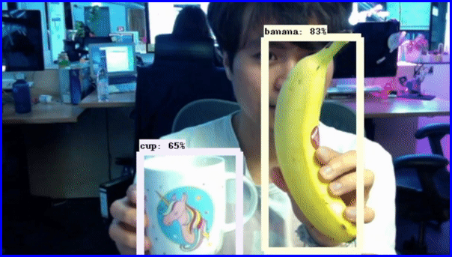

Slide 40
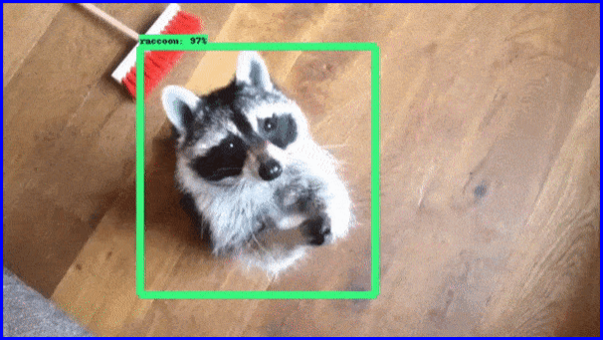

Slide 41
